Slide 1
W-51 TOWER INSTALLATION
The smaller W-51 tower needed an appropriate base, so K6OK designed a new rebar cage and base assembly. The hole was to be 48 X 48 X 40 inches. The rebar frame was 42 X 42 X 32

Slide 2
Wilton hardpan requires a 20 pound jack hammer. Adult children are also useful.

Slide 3
Cleaning out

Slide 4
When water was added to the hole overnight to help digging, some critter stopped by to investigate. Lucky the hole wasn’t too deep at the time and he could get out. Trapping a skunk in a deep hole would be a serious problem. This critter: a raccoon.

Slide 5
Half inch (#4) weldable rebar was used for all bracing. A fixture was made to hold the bars while welding. Six squares were made and overlapped. The final levels were welded to the #5 vertical corners.

Slide 6
Welding Fixture

Slide 7
The three long plates and the shorter plate, used to mount the raising fixture, were welded to the #8 rebar. The bracing was attached using a portable wire welder while the legs were mounted to the tower. The base was removed and then re-welded with the arc welder to assure strength. This extra welding would prove to save the project.

Slide 8
The cage was placed into the hole that had 4 inches of gravel and some bricks used to reach the appropriate level. The base is inserted in the middle of the frame. The notching of the 2X4s allows the level to sit on the tower attachment plates.

Slide 9
The tops of the ears were leveled in all directions. Support 2X4s hold the base in position and are screwed to some foundation stakes. The 48 X 48 top frame is supported and leveled in the same way.

Slide 10
CONCRETE
With the frame ready, I ordered 2.5 yards of 6 sack concrete. The concrete company could deliver that afternoon or in a week. I choose to try to do it all alone that afternoon (ERROR).
The truck arrived and started pouring into the left side. I had problems spreading out the very stiff concrete. Driver made it worse by dumping a yard on the left side. He reset and finished the pour into the middle of the forms.
As it tried to clean up the surface and finish off the edges, I noticed that the right corner of the base is a half inch high. The mass of concrete has pushed and rotated the base. I was too busy to notice the frame getting out of level (DISASTER).

Slide 11
FINAL ACT OF DESPERATION
Once concrete is poured, its almost impossible to move any frame to correct a problem. I tried everything I could think of to get the frame level. Nothing worked and the concrete was drying (PANIC). A lot of time and money was about to be lost.
In frustration, I took an 8 pound sledge-hammer and bashed the right corner of the frame. It slightly moved! There was now hope but I had to act fast.
Bumper jacks were placed under the supports for the left and rear corners. Continued pounding of the right corner resulted in the frame slowly coming into level. I was exhausted after over an hour of effort.

Slide 12
THE BASE FROM HELL

Slide 13
RAISING FIXTURE INSTALLED. It’s almost as heavy as the tower, so some cheap wheels were added to the front holes and the fixture was dragged to the base.

Slide 14
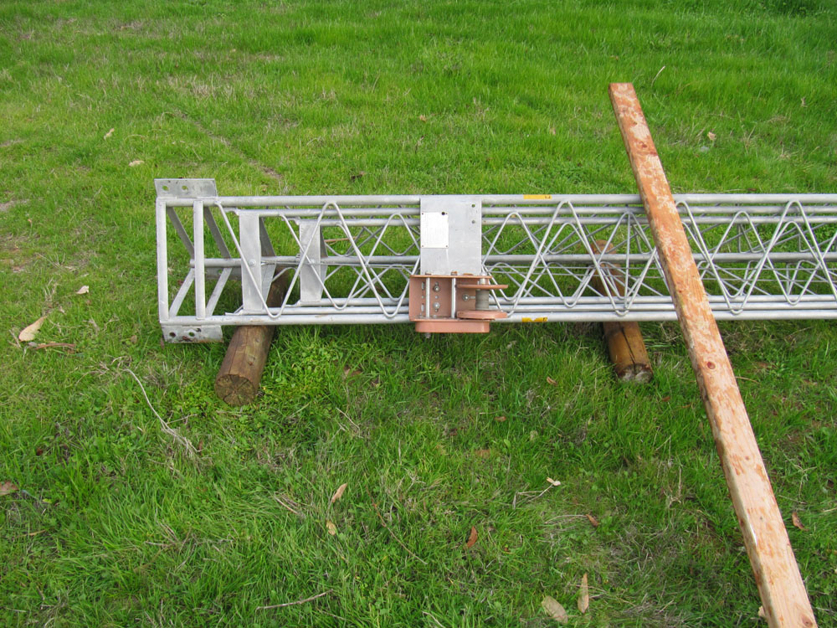
The base is ready, but the tower is 140 feet away and I have run out of help. It was time to go old school: “GO EGYPTIAN”. Peeler cores were cut to make 4 rollers. With a 2X4 for an adjuster, the tower was moved over uneven ground to the base in about 20 minutes.

Slide 15
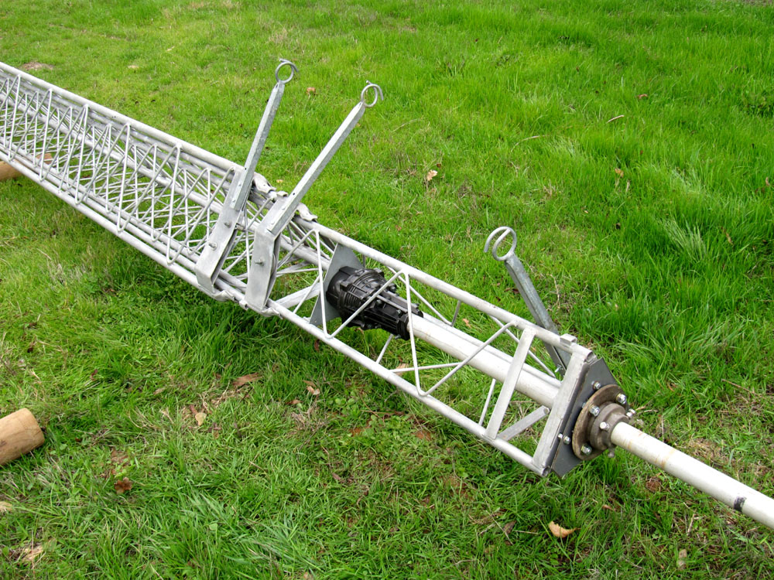
Cable and pulley are rigged and the tower is ready to go vertical. The rotor, thrust bearing, mast and side arms were installed first.

Slide 16
A pulley was rigged on the mast and the 30 meter beam was hoisted into place. Rotor cable and coax was attached and tested before the tower was raised to full height.

Slide 17
LESSONS LEARNED
Never do concrete pouring work alone. You need more hands and eyes.
If you have tough soil, rent the jack hammer.
Specify all rebar to be made for welding (W).
Specify “wet” poured cement.
Always cover the hole at night.
Weld the base support with an arc welder. You may need the extra strength.
Always have a sledge-hammer handy.
Never give up. Walking away assures failure.

Slide 18
COSTS
Steel fabrication: $58.74
Shop welding (required on the ears): $60
Cement delivered: $573.72
Jack-hammer rental (1 day): $86.33
Rebar was all cut to size: $62.00
DIY savings: $500+

